Slide 1
RENTAL PLATFORM DATABASE PROJECT

Slide 2
HIGHLIGHTS
HIGHLY SECURE DATABASE DESIGN with a dedicated database user for each new customer with access restricted using roles.
FULLY AUTOMATED through SQL scripts. one click to initialize the whole database. one click to purge the whole database. Scripts can be run multiple times

Slide 3
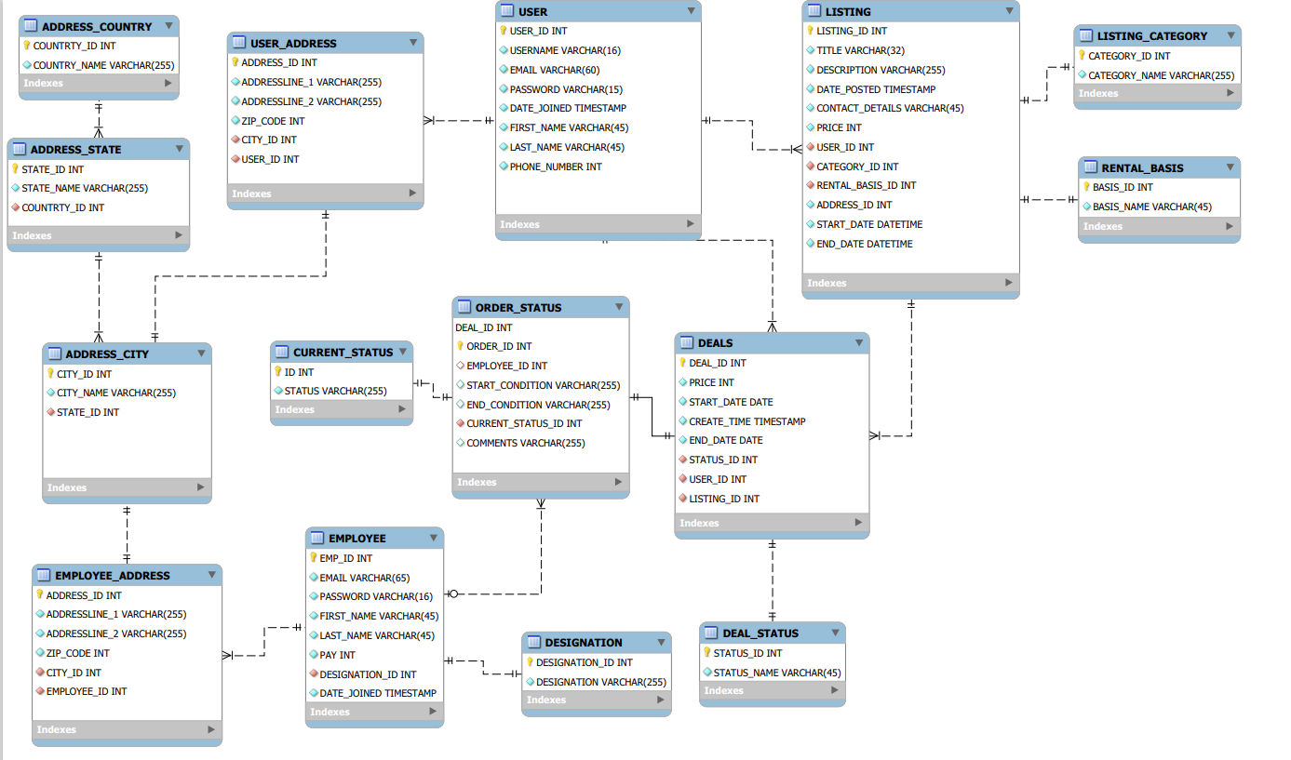
ER DIAGRAM

Slide 4
FEATURES
PL/SQL PROCEDURE DRIVEN APPROACH
PACKAGES
CUSTOM VIEWS FOR EACH USER
SYNONYMS
MATERIALIZED VIEWS
TRIGGERS
REGULAR EXPRESSIONS
INDEXES
CURSORS
USER ROLES
SECURE FROM SQL INJECTIONS
DEAD LOCK AVOIDANCE MECHANISM

Slide 5
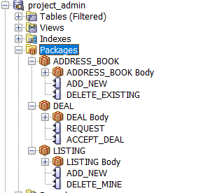
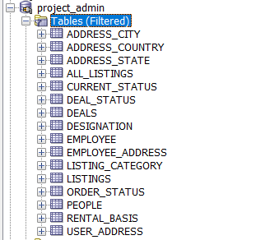
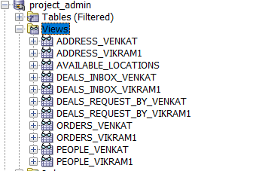
DATABASE OBJECTS

Slide 6
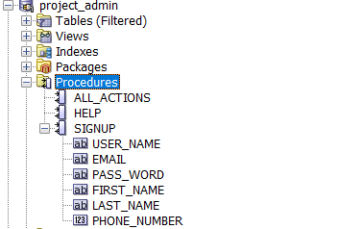


DATABASE OBJECTS

Slide 7
LETS GET TO ACTION!
RUN THE 0.CREATE_PROJECT_ADMIN.SQL FILE
RUN THE 1.INITIALIZE DATABASE.SQL FILE
CONNECT WITH THE NEW CUSTOMER USER
SIGNUP FOR AN ACCOUNT
CONNECT TO YOUR ACCOUNT AND START USING!

Slide 8
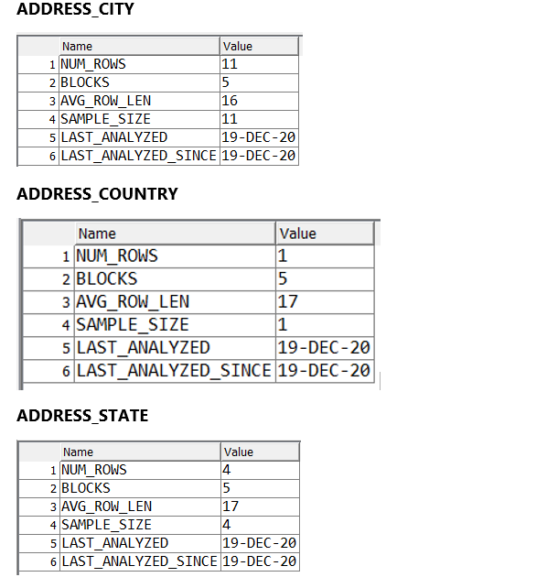
STATISTICS REPORTS

Slide 9
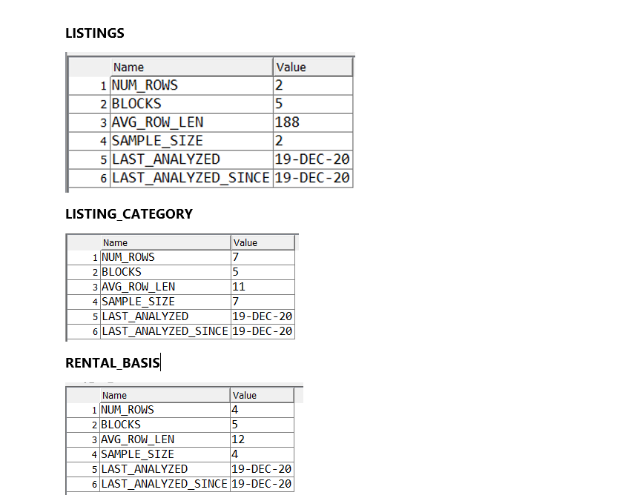
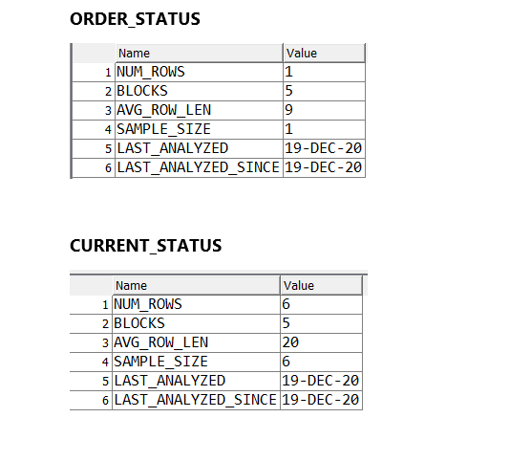
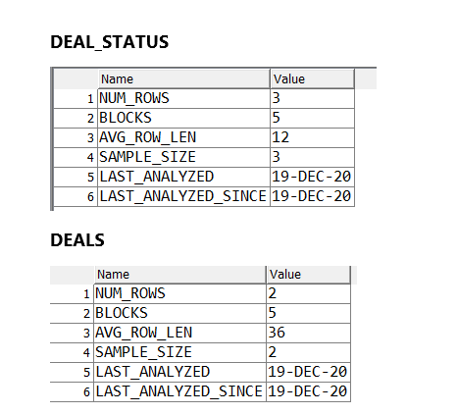
STATISTICS REPORTS

Slide 10
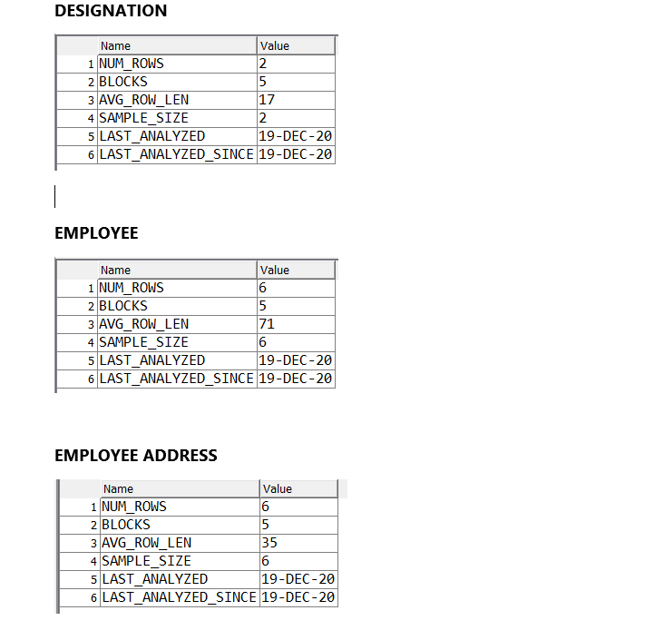
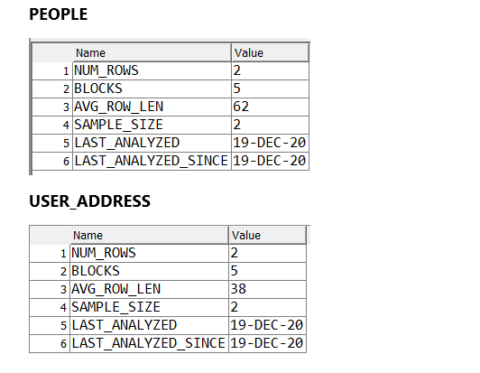
STATISTICS REPORTS

Slide 11
THANK YOU!

